Slide 1
Let’s Begin Python
Lesson 3.1
Notes:
1.1

Slide 2
Class Objectives
By the end of today’s class you will be able to:
Perform Python 3 installation.
Navigate thru folders and files via terminal / git-bash.
Create Python scripts and run them in terminal /git-bash.
Understand basic programming concepts in Python.

Slide 3
Some basic commands
cd (Changes the directory).
cd ~ (Changes to the home directory).
cd .. (Moves up one directory).
ls (Lists files in the folder).
pwd (Shows the current directory).
Mkdir <FOLDERNAME> (Creates a new directory with the FOLDERNAME)
touch <FOLDERNAME> (Creates a new file with the FILENAME).
rm <FOLDERNAME> (Deletes a file).
rm -r (Deletes a folder, make sure to note the -r).
open . (Opens the current folder on Macs).
explorer . (Opens the current folder on GitBash).
open <FILENAME> (Opens a specific file on Macs).
explorer <FILENAME> (Opens a specific file on GitBash).

Slide 4
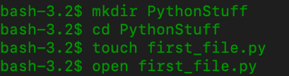
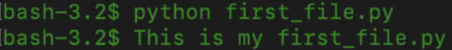
Common Commands
Notes:
Note - image on slide 8 is for mac - and image on LP is windows -
This is basic terminal navigation, from here show how students can edit Python files and run in terminal.
Create and navigate into a PythonStuff folder on the desktop.
Create and open first_file.py using the text editor.
Add print("This is my first Python file") and save the code.
Return to the terminal and run the file using python first_file.py.
Explain that python <FILENAME>.py tells the computer that this is a python file and to run the code contained within.
Repeat again with second_file.py using the code print("This is my second python file").

Slide 5
Everyone Do: Check Anaconda installation
In this activity, we will check if Anaconda is properly installed.
5 Minutes
Notes:
2.1

Slide 6
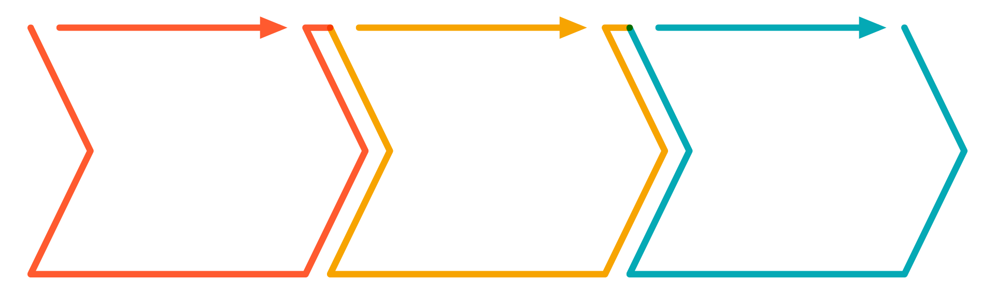
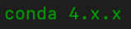
Everyone Do: Check Anaconda Installation
Check if Anaconda is properly installed
Open up terminal
2. Run
conda --version
and hit enter
3. Terminal output should return

Slide 7
Everyone Do: Create a Virtual Environment
What is a Virtual Environment?
Virtual environments create an isolated environment for Python projects.
You may be working on different projects that have different dependencies.
Different projects might also use different types and versions of libraries.
This virtual environment will make sure the class has all the right dependencies for future class activities.

Slide 8
Everyone Do: Create a Virtual Environment
How to create a Virtual Environment and activate it?
Create environment
Activate new environment
Run:
conda create -n PythonData python=3.6 anaconda
Run:
source activate PythonData
Or
conda activate PythonData

Slide 9
Everyone Do: Create a Virtual Environment
Check python version in the new environment. Exit the environment.
Check python version
Deactivate new environment
Once in the new environment run the command:
python --version
Run:
source deactivate
Or
conda deactivate

Slide 10
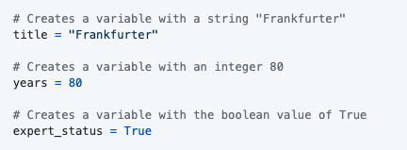
Variables
Similar to values stored in VBA cells
In Python, a value is being stored and given a name
Variables can store different data types like strings, integers and an entirely new data type called booleans which hold True or False values.

Slide 11
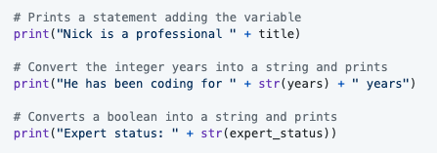
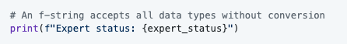
Print Statements
We can print statements which include variables, but traditional Python formatting won't concatenate strings with other data types. This means integers and booleans must be cast as strings using the str() function.
Alternatively, the "f-string" method of string interpolation allows strings to be formatted with different data types. Demonstrate the differences by refactoring the last print statement as an "f-string":

Slide 12
Print Statements
We can print statements which include variables, but traditional Python formatting won't concatenate strings with other data types. This means integers and booleans must be cast as strings using the str() function.
Alternatively, the "f-string" method of string interpolation allows strings to be formatted with different data types. Demonstrate the differences by refactoring the last print statement as an "f-string":

Slide 13
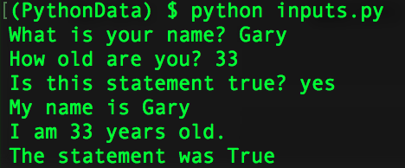
Inputs and Prompts

Slide 14
Conditionals
Few things to keep in mind!
Conditionals in Python carry nearly the same logic as in VBA. The primary difference is the syntax and indentation.
Python uses if, elif, and else for creating contionals.
Conditional statements are concluded with a colon but all lines after the colon must be indented to be considered a part of that code block. This is because Python reads blocks of code based on indentation.
All sorts of operators like greater than, less than, equal to, and much more can be used to create logic tests for conditionals.
The condition is equal to uses == while variable assignment uses one equal sign.
Multiple logic tests can be checked within a single conditional statement. Using the term and must mean both tests return True while or require that only one test return as true.
Conditionals can even be nested, allowing programmers to run logic tests based upon whether or not the original logic test returned as True.

Slide 15
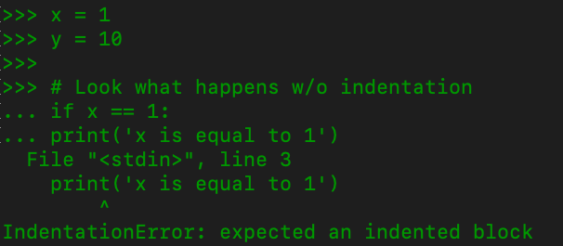
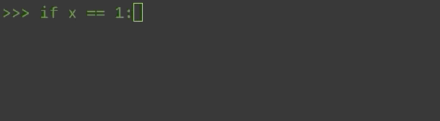

Conditionals
Indentation matters in Python!
Hint: count four ‘space’ stroke on your keyboard or hit ‘tab’ once

Slide 16
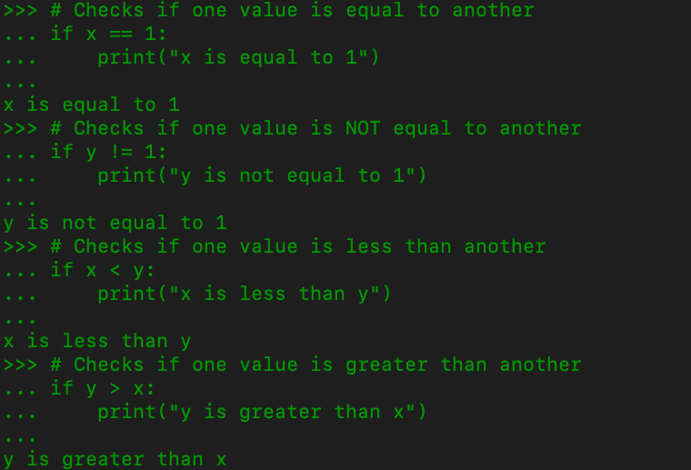
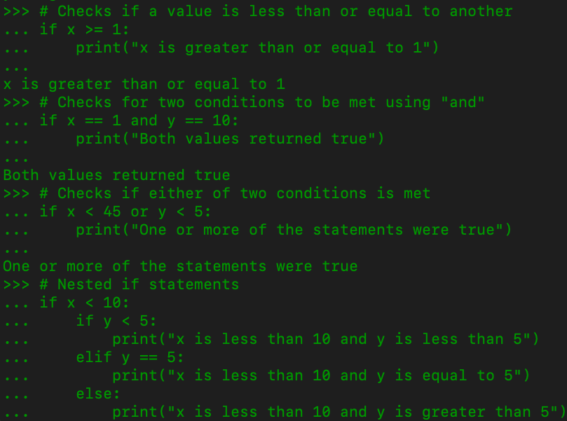
Conditionals

Slide 17
Lists
Couple of points to keep in mind before we move forward
Lists are the Python equivalent of arrays in VBA, functioning in much the same way by holding multiple pieces of data within one variable.
Lists can hold multiple types of data inside of them as well. This means that strings, integers, and boolean values can be stored within a single list.

Slide 18
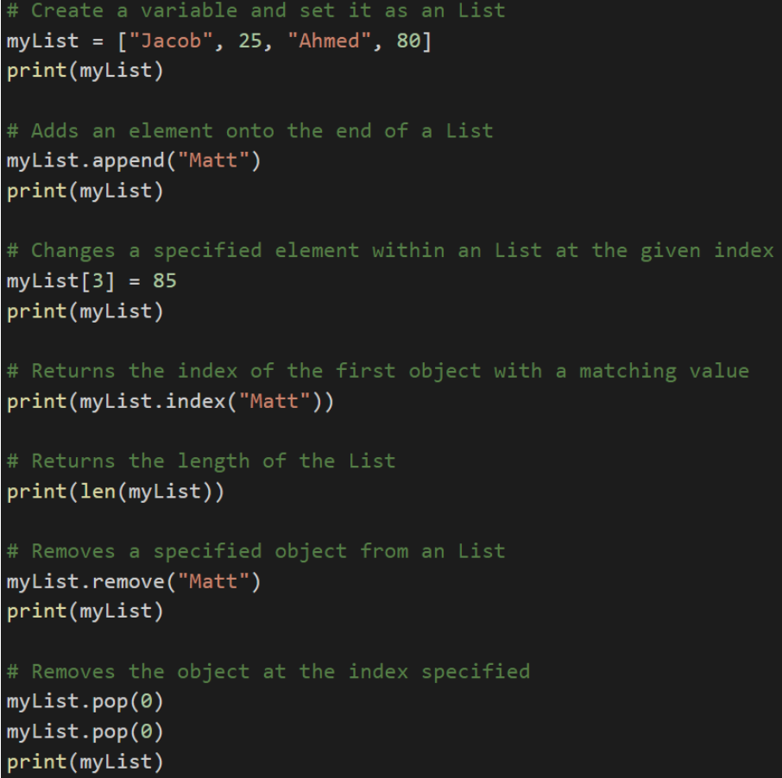
Lists Methods in Python
Python has a set of built-in methods that you can use on lists
The append method can add elements on to the end of a list.
The index method returns the numeric location of a given value within a list.
The len function returns the length of a list.
The remove method deletes a given value from a list.
The pop method can be used to remove a value by index.

Slide 19
Tuples
Tuples are functionally similar to lists in what they can store but are immutable
While lists in Python can be modified after their creation, tuples can never be modified after their declaration.
Tuples tend to be more efficient to navigate through than lists and also protect the data stored within from being changed.

Slide 20
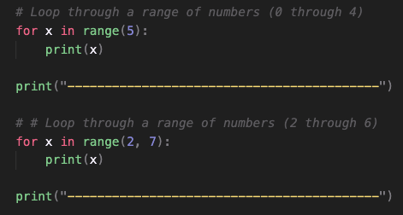
Loops
Loops is also a concept we covered during VBA!
The variable x is created within the loop statement and could theoretically take on any name so long as it is unique.
When looping through a range of numbers, Python will halt the loop one number before the final number. For example, when looping from 0 to 5, the code will run five times, but x will only ever be printed as 0 through 4.
When provided with a single number, range() will always start the loop at 0. When provided with two numbers, however, the code will loop from the first number until it reaches one less than the second number.

Slide 21
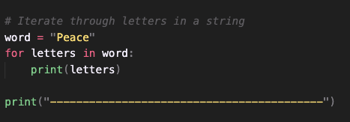
Looping through strings
Python can also loop through all of the letters within a string
The syntax is for <variable> in <string>:

Slide 22
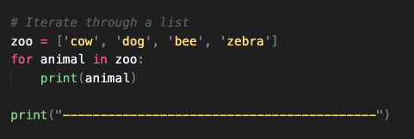
Looping through lists
Python can also loop through all of the values within a list
The syntax is for <variable> in <list>:

Slide 23
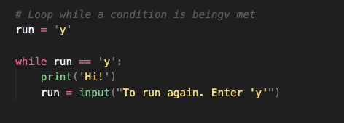
While loops
Just like a for loop but will continue looping for as long as a condition is met

